Slide 1
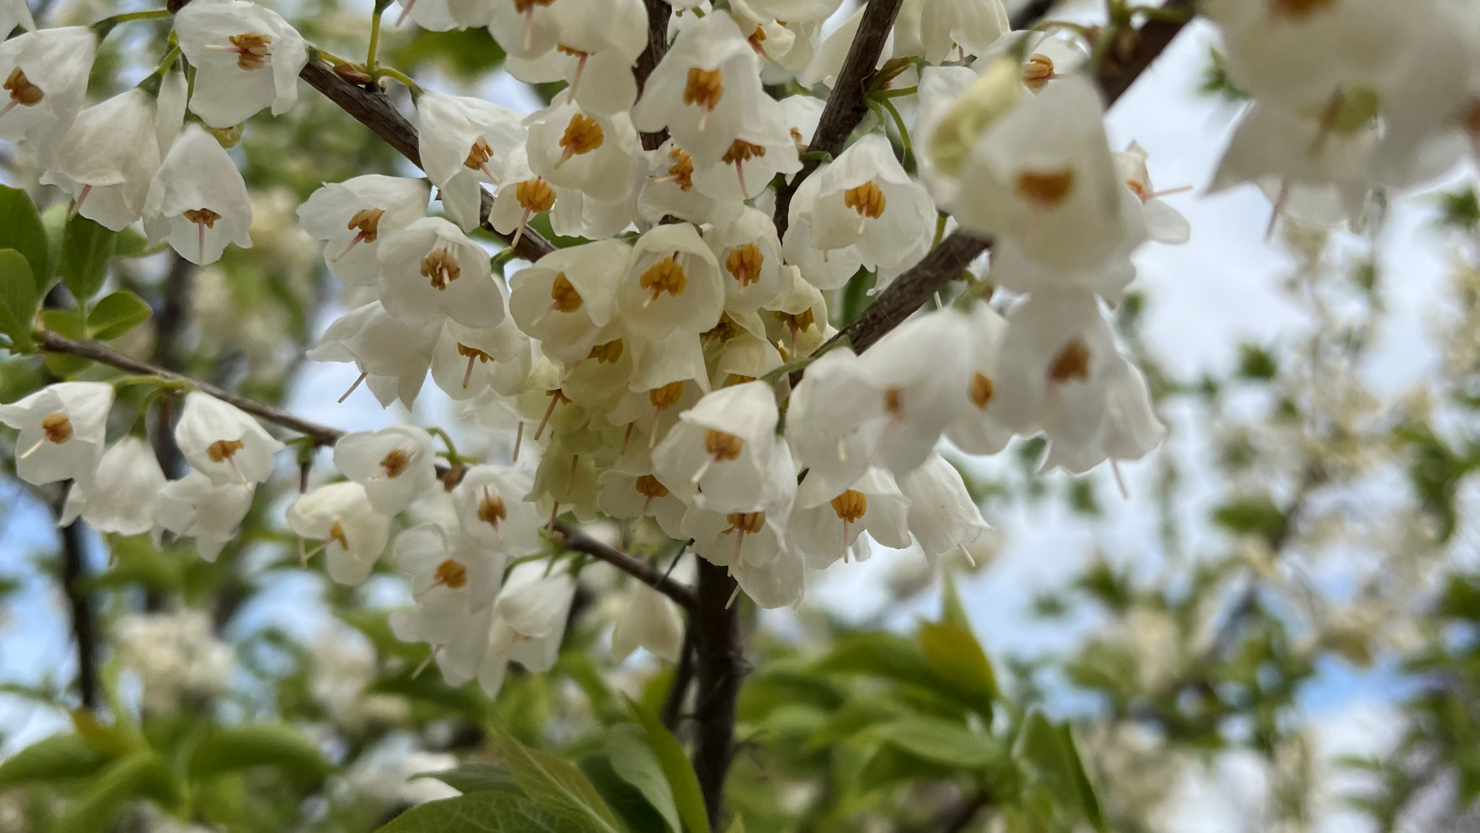
LET’S TALK TREES!
March 30, 2023
Hosted by: Sustainable Audubon
Presenter: Aimee Bentley

Slide 2
AGENDA
Introduction
The Importance of Shade Trees in our Community
Facts about Trees
The Tree Canopy in Audubon
What Tree to Plant Where
The Audubon Shade Tree Initiative

Slide 3
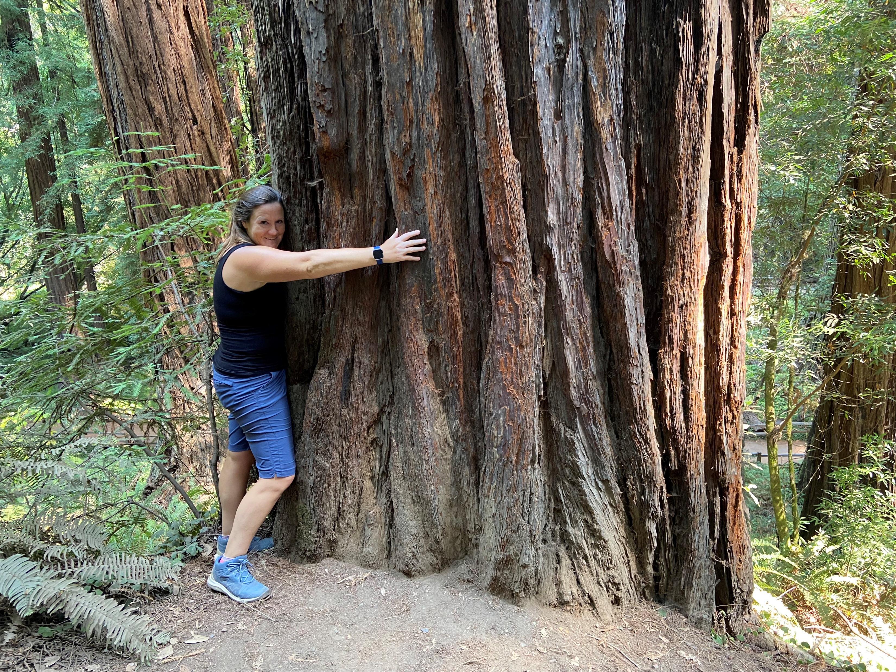
Introduction
Audubon resident since 2012
Self-Proclaimed Tree Hugger
B.S. in Ornamental Horticulture and Environmental Design
Certified Crop Advisor and Nutrient Management Consultant
Member, Camden County Agriculture Development Board
Worked in landscape industry for 15 years
Currently working in Sustainable Agriculture
Joined Sustainable Audubon in 2022

Slide 4
The Importance of Shade Trees in Our Community
Benefits:
Environmental
Decreases stormwater runoff
Removal of air pollutants
Conserves Energy (economic benefit as well)
Economic
Increases property value
Increases value to commercial districts
Decrease in average electric bill
Social
Decrease in motor vehicle speed
Decrease in street noise
Makes streets more walkable
Aesthetically pleasing
Screen unsightly concrete
Screen utility poles

Slide 5
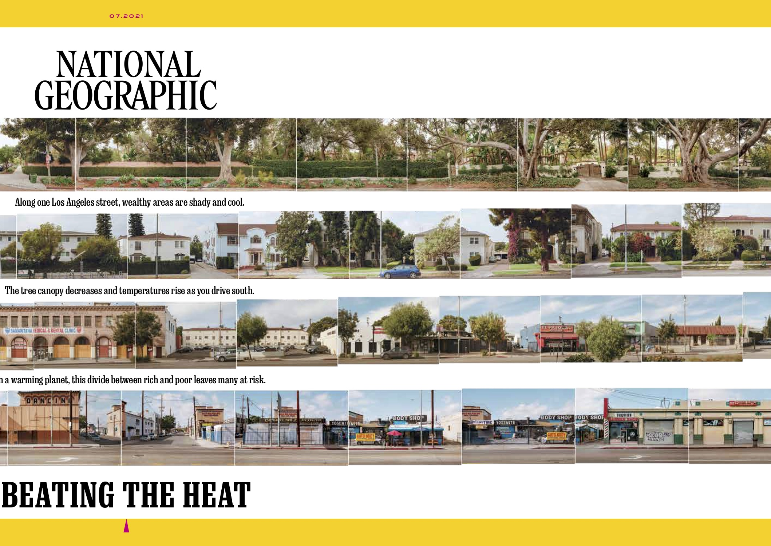
The Importance of Shade Trees in Our Community
The tree canopy in Los Angeles reflects Urban inequity
Trees become sparser and neighborhoods hotter as you drive from North to South
In wealthier areas the ratio of tree canopy to impervious surfaces is about equal

Slide 6
Facts about Trees in a Neighborhood
The U.S. Forest Service estimates that the presence of street trees increases adjacent home values by an average of $13,000
Homes, goods and services sell for 12 % more in communities with trees than in those without trees
Pavement can cause temperatures to rise 3-7 degrees, which increases energy costs and the presence of harmful ozone and other gases. Tree shade can lower energy bills by up to 35%
For a planting and three-year maintenance cost of $250 to $600, a single street tree returns more than $90,000 of direct benefits, not including the aesthetic, social and natural benefits provided during the tree’s lifetime

Slide 7
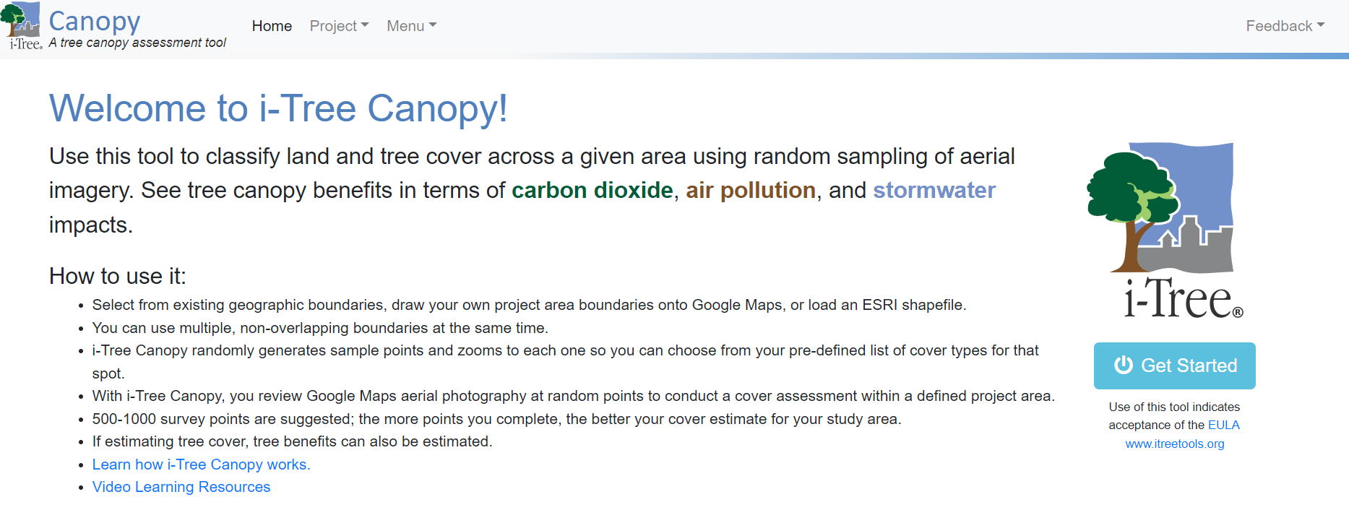
The Tree Canopy in Audubon
https://canopy.itreetools.org/

Slide 8
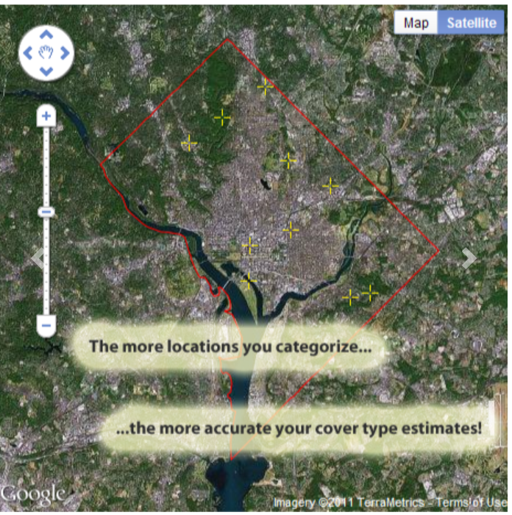
i-Tree Canopy
How it Works
Outline project area boundaries
Random sample points are generated and zoomed in
Determine cover type of sample point using a pre-defined list
The more sample points that are identified, the more accurate the analysis

Slide 9
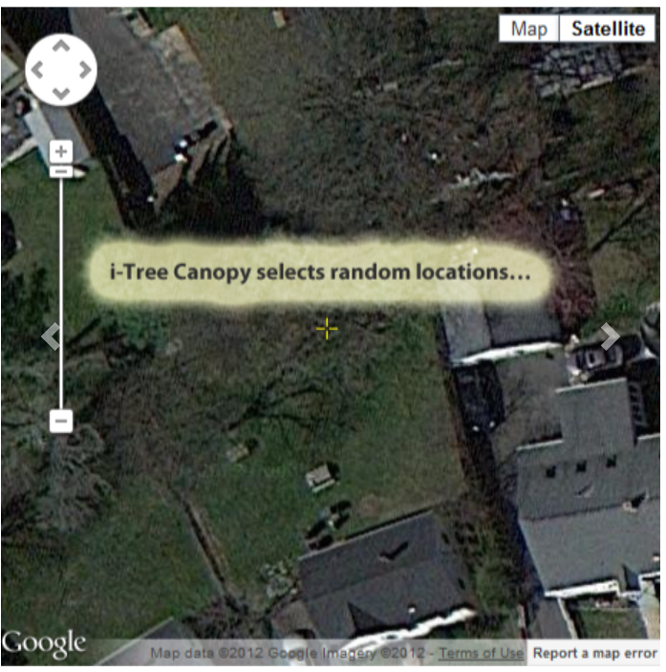
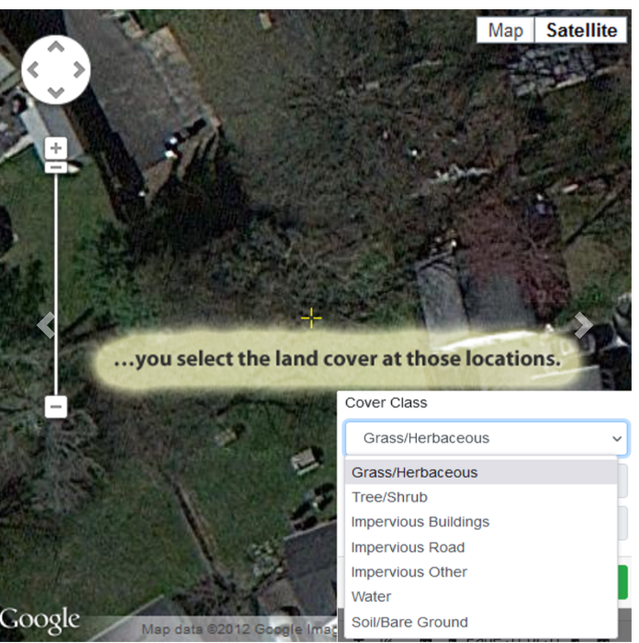
i-Tree Canopy – How it Works

Slide 10
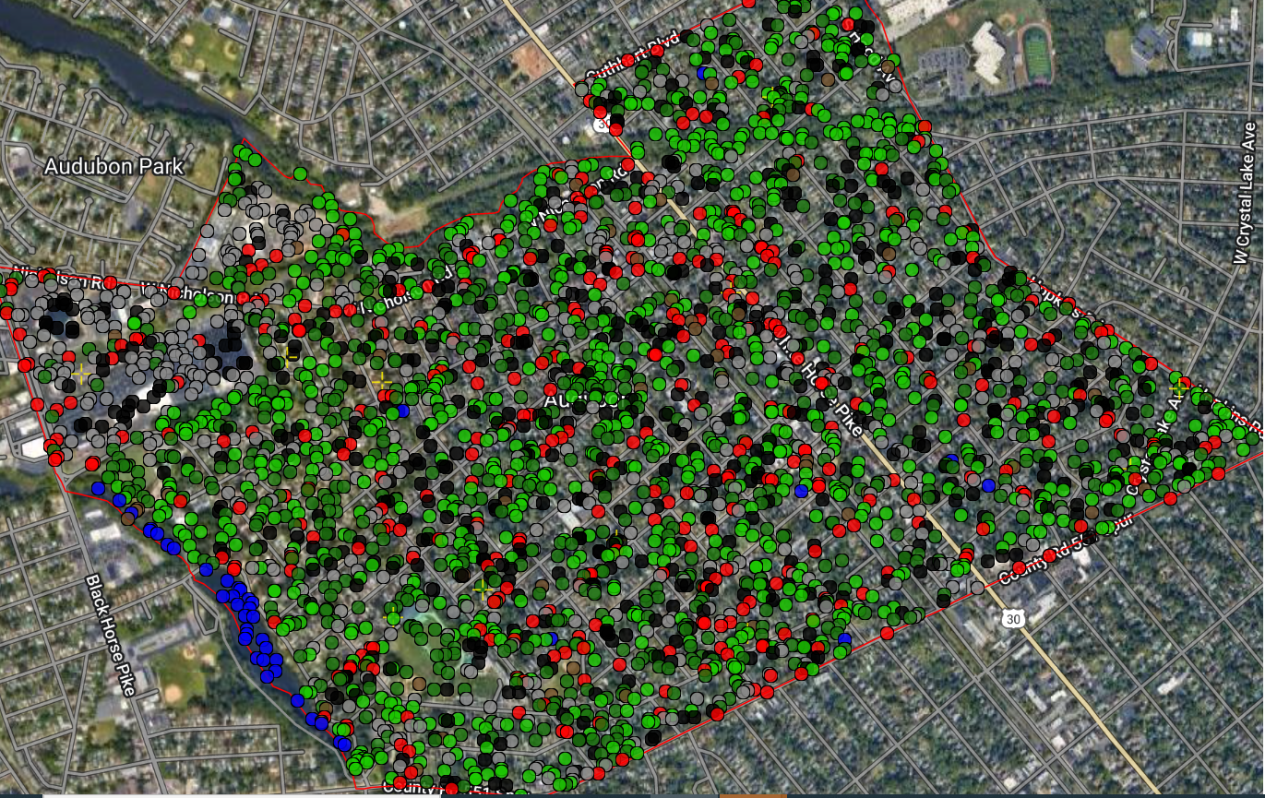
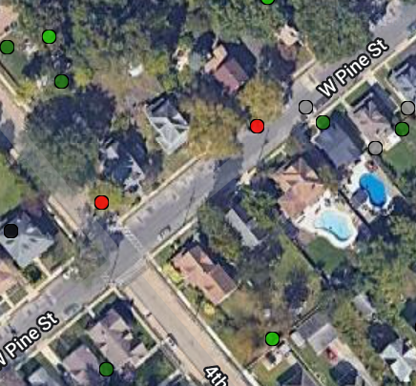
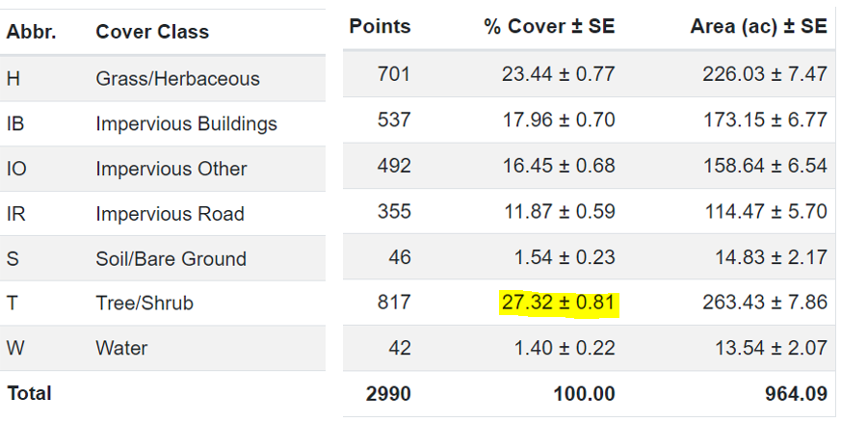
The Tree Canopy in Audubon

Slide 11
The Tree Canopy in Audubon

Slide 12
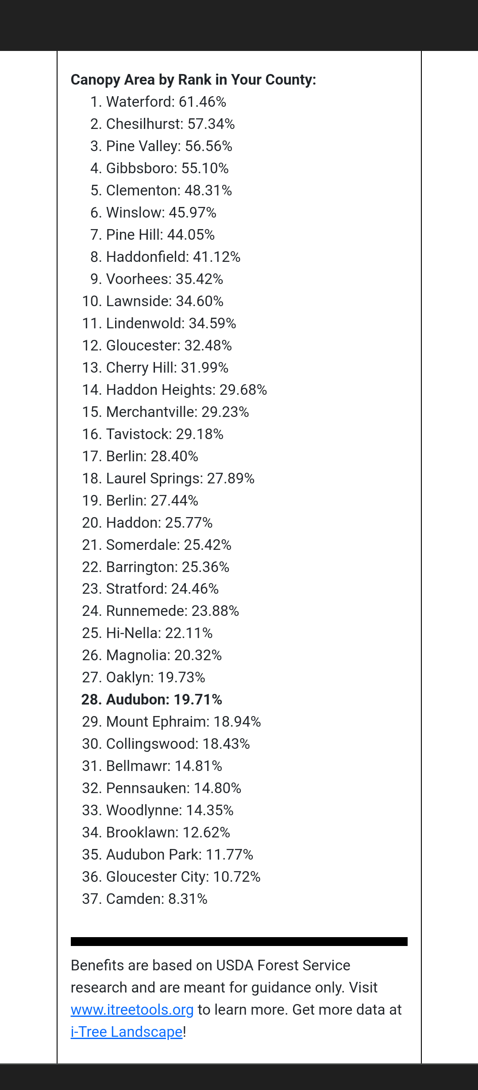
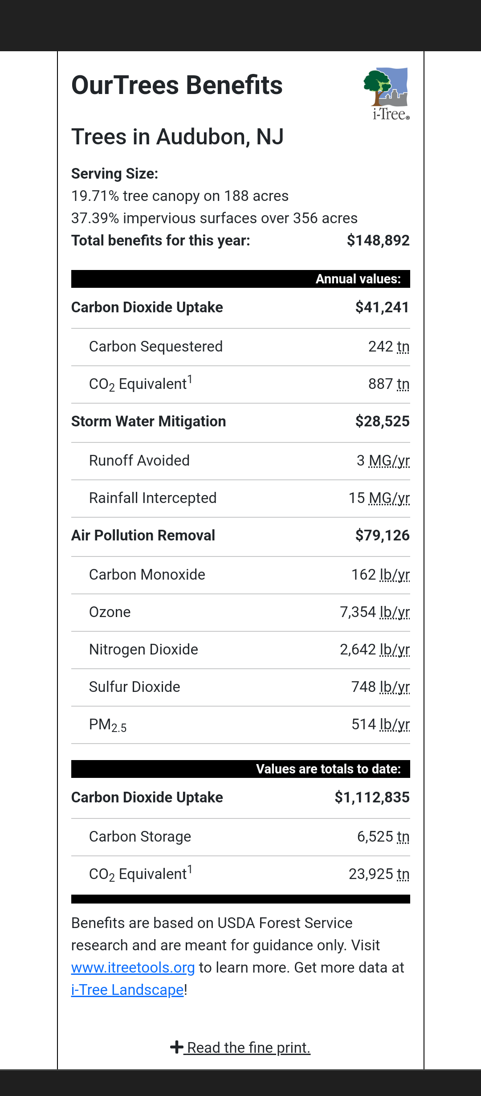
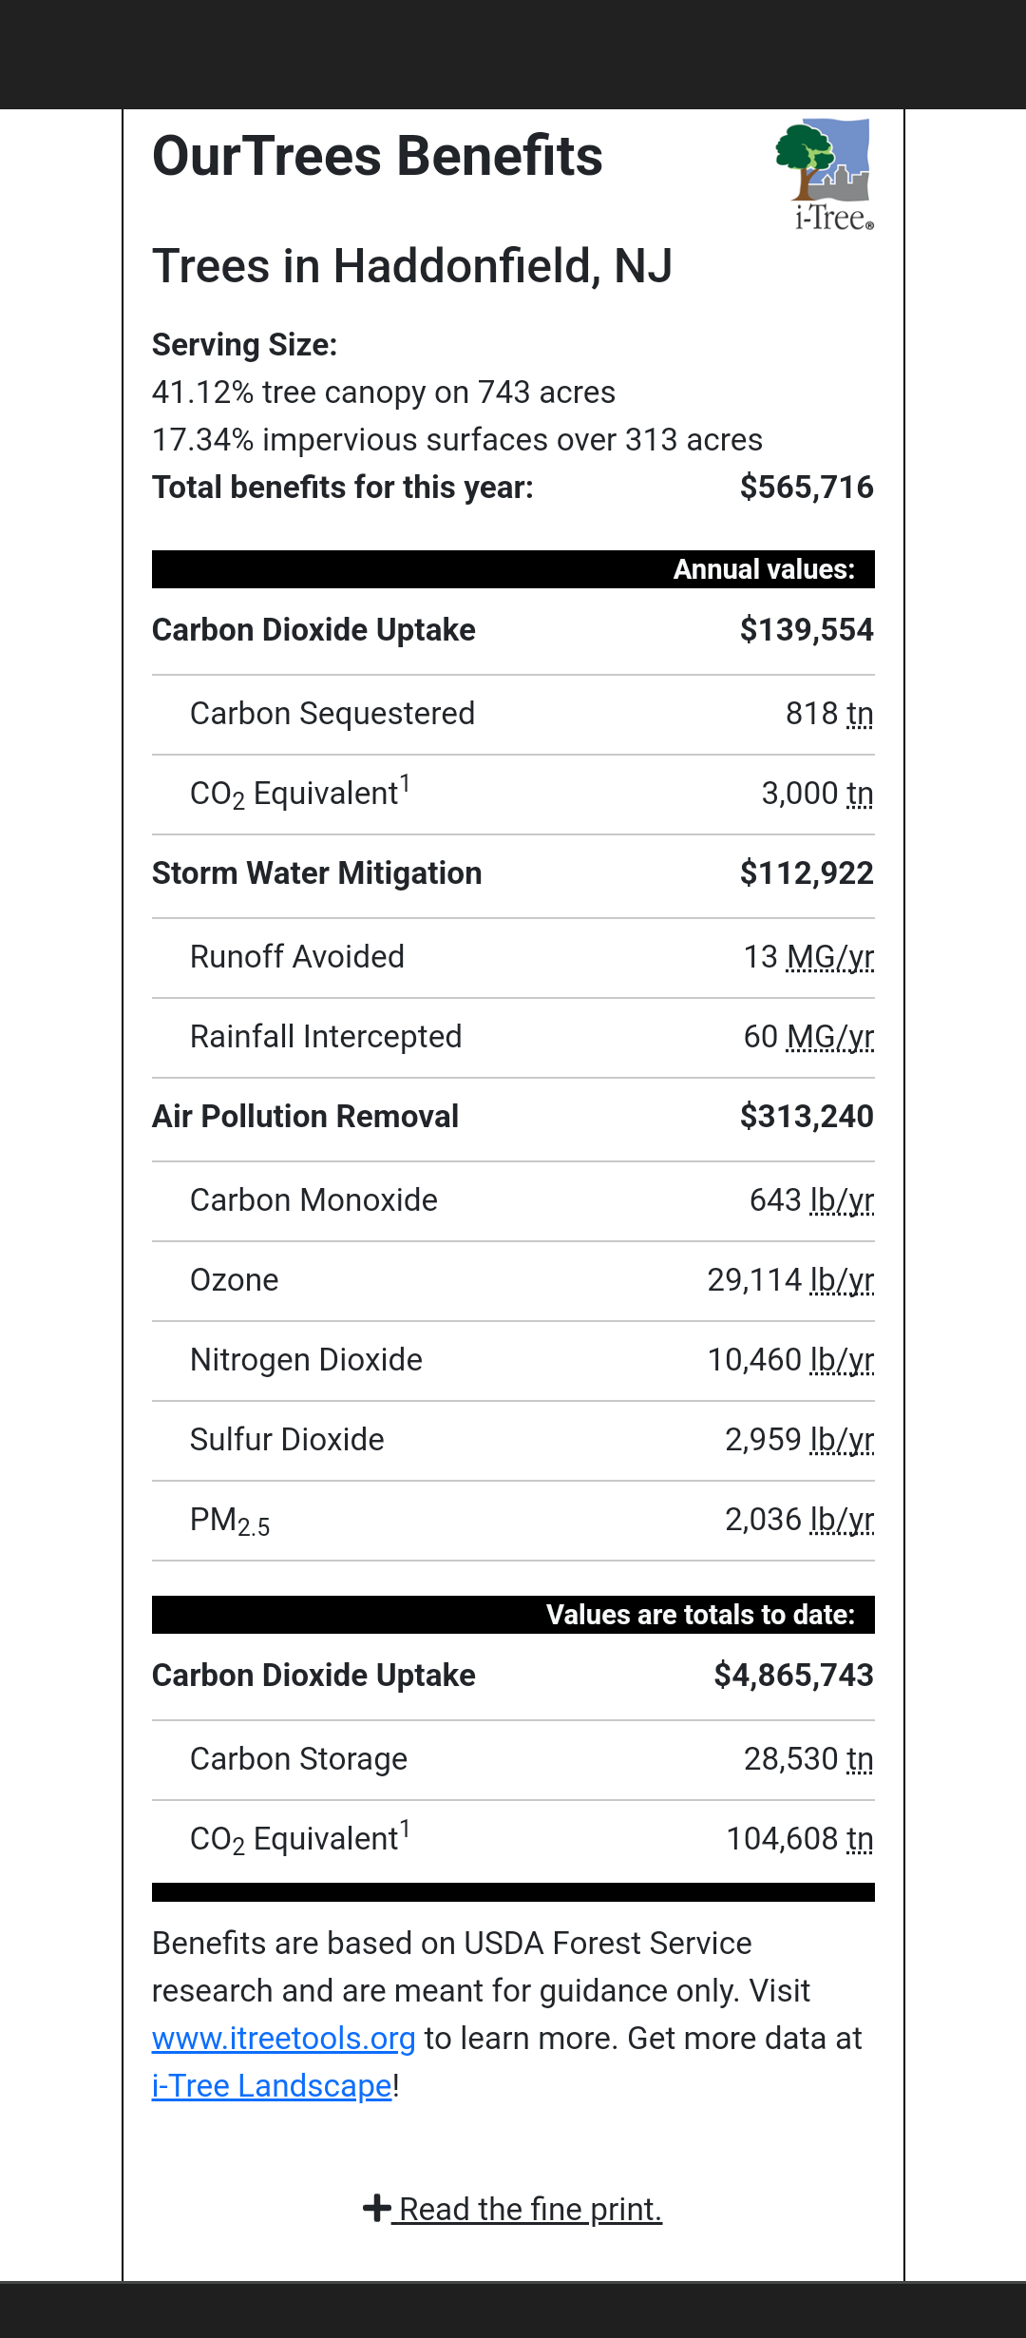
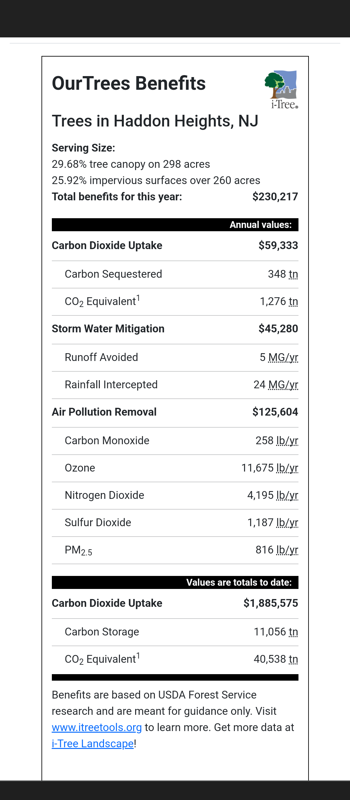
Tree Canopy
How Does Audubon Compare?

Slide 13
What Tree to Plant Where
Site Analysis- Evaluate area and consider the following
Overhead wires, lights, signs
Underground utilities
Exposure to wind
Light conditions during the day
Distance from surrounding trees and their canopy
Distance to nearby buildings
Tree Species Selection
Choose based on local climate and utilizing native trees as often as possible
Respect the water needs of the tree
Consider the type of root system- deep rooted or shallow?
Utilize information from surrounding municipalities and what tree selections work for them
Width of curb strip
Consider susceptibility to insect and disease

Slide 14

Audubon Street Tree Initiative
Outline of Plan for Street Tree Plantings
Gather Tree Inventory- itreetools.org
EVALUATE INTEREST FROM RESIDENTS *
  Door to Door letters
  Public Meetings
  Surveys conducted at town events
Site Analysis
Provide a List of Acceptable Trees for Curb Strip and Open Public Space Areas
Develop an After Planting Care Sheet for Trees
Future Legislation
  Establish ordinances to require any future developers to survey all trees to be removed and provide a payment for trees that are not replaced (“tree bank”)
  Possibility of future development/construction in town to include the planting of a certain number of trees on the property under construction
  Incorporate a yearly budget for tree planting into overall town budget

Slide 15
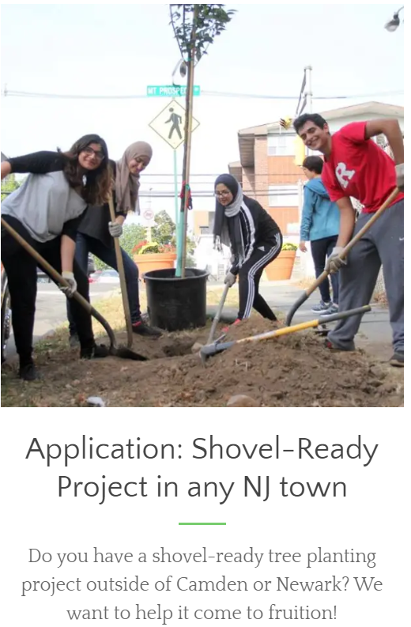
Audubon Street
Tree Initiative
Njtrees.org
Qualifying projects need a minimum of 20 trees
Projects ideally already have approval by the property owners and/or municipality.
  Public Property Only
Maintenance plans should be in place to care for the trees for at least two years following planting.
The NJ Tree Foundation will work with you to find and apply for grants to fund the project

Slide 16
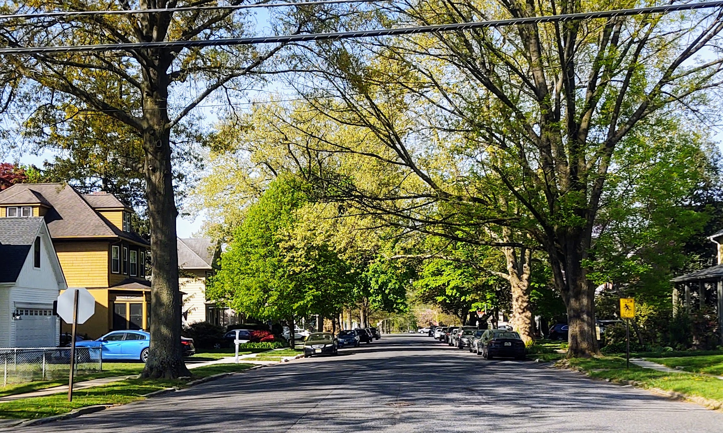
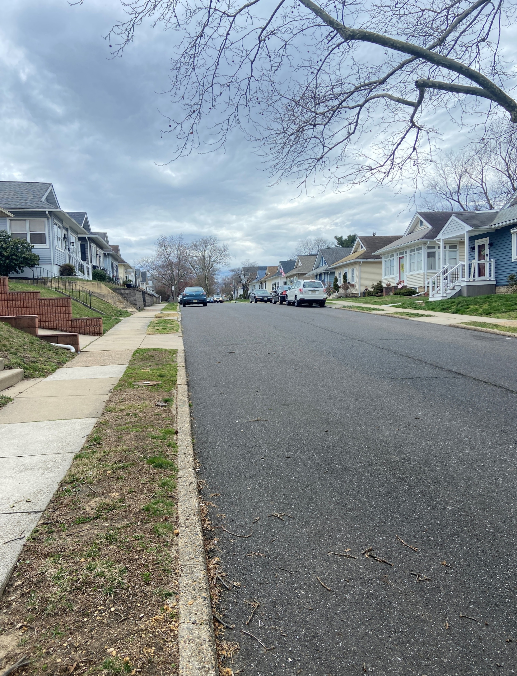
Audubon’s Tree Canopy
Potential & Opportunity

Slide 17
Sources
Burden, D. Walkable Communities, Inc., Glatting Jackson. (2006) Urban Street Trees: 22 Benefits, Specific Applications. http://www.michigan.gov/documents/dnr/22_ benefits_208084_7.pdf 2.
Donovan, G.H., Butry, D.T. (2009) “Trees in the city: Valuing street trees in Portland, Oregon”. Landscape and Urban Planning. (2010) Vol. 94, pp 77–83 http://www. fs.fed.us/pnw/research/gcra/pdfs/pnw_2010_donovan001.pdf
Dumbaugh, Eric (2005) “Safe streets, livable streets.” Journal of the American Planning Association, Vol. 71, No. 3, pp 283–300
Burden, D. Walkable Communities, Inc., Glatting Jackson. (2006) Urban Street Trees: 22 Benefits, Specific Applications. http://www.michigan.gov/documents/dnr/22_ benefits_208084_7.pdf
Wolf, K. L. University of Washington. (August 2009) Trees Mean Business: City Trees and the Retail Streetscape. http://www.naturewithin.info/CityBiz/MainStreetNews_ Aug09_Trees.pdf

